Slide 1
Discussion Unit:
Migrate a set of DSE Analytics REPL statements, to a (true) Scala program
Command line first, then IDE; (Discussion Unit/Exercise 7556/7557)
Software versions
Install Scala, Maven
Generate a pom.xml, change
Generate an App.scala, change
Submit as Spark job
This Discussion Unit is dependent on Discussion Unit 7544/7545.
DSE Analytics Scala REPL statements migrated to program
Notes:
The goal of this Discussion Unit is to take the work completed in Discussion Unit 7544/7545, and make it part of a true Scala program.
Topics include:
Command line first, then IDE (another Discussion Unit/Exercise 7556/7557)
Software versions
Install Scala, Maven
Generate a pom.xml, change
Generate an App.scala, change
Submit as Spark job
This Discussion Unit is dependent on Discussion Unit 7544/7545.

Slide 2
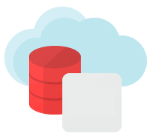


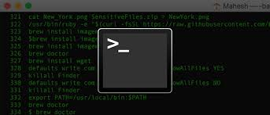

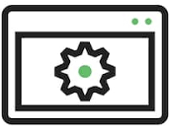


Discussion Lab:
DSE
Java Driver
Matching pairs – Match the attributes on the right with the areas on the left
DSE
Spark Cassandra
Connector
Notes:
On the next page we enter a Discussion Lab.

Slide 3

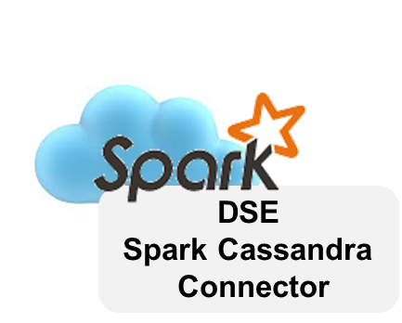
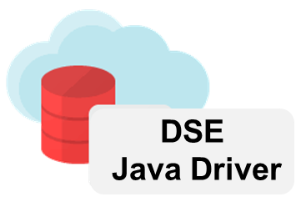
Discussion Lab: Attributes
REPL
(True)
Program
Faster to develop
Deploy to production
More memory (laptop ?)
Less memory (laptop ?)
Client uses different IDE
Access to client network
Command
Line
DSE Spark client
IDE
DSE Java client
Notes:
Matching pairs Discussion Lab: REPL, program, DSE Spark Cassandra Connector, DSE Java driver, command line, IDE
Match the attributes on the right with the objects on the left.

Slide 4
End of Discussion Lab:
Notes:
End of Discussion Lab-

Slide 5


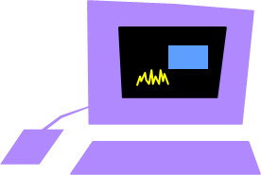

[ What ] is interacting with DSE ?
There are JDBC, ODBC, Parquet, (other) connectors built into Spark, but there is not a (Cassandra) one
DataStax provides 2 drivers that work interactively
DSE Java Driver (See Discussion Unit, 6244/6245) (not Spark)
Spark Cassandra Connector (Spark)
-- Open source, AND enterprise license features
-- Spark objects, activities
These allow you to connect to DSE directly from Spark, like using a JDBC driver, more
Java,
Java Driver
DSE
DSE Spark
Cassandra
Connector
DSE
Spark
Notes:
The DSE Spark Cassandra Connector provides access to Spark contents, Spark session, other. The DSE Java driver does none of this, and is designed for standard client (ODBC/JDBC style) access; the DSE Java driver is ODBC-like, but is not ODBC compliant.
Reference Urls:
DSE Java Driver (Java, Scala, other JVM), https://docs.datastax.com/en/developer/java-driver-dse/1.6/
DSE Spark Cassandra Connector, version 2.3 (2.0), https://github.com/datastax/spark-cassandra-connector
http://datastax.github.io/spark-cassandra-connector/ApiDocs/2.3.0/spark-cassandra-connector/#package
https://github.com/datastax/spark-cassandra-connector/blob/master/README.md

Slide 6
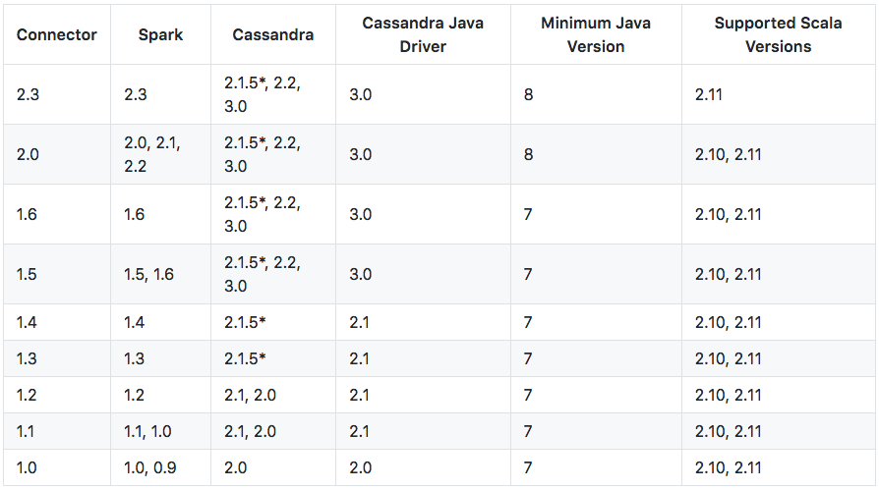
Versions: They Matter
DSE 6.0, 6.0.1
Java 8
Spark 2.2.1.2
Scala 2.11, 2.12
Notes:
Because DSE Analytics (Apache Spark) operates server side, it is generally more critical that software versions match; versus say, when running a standard client program against DSE.
Reference Urls:
https://docs.datastax.com/en/dse/6.0/dse-dev/datastax_enterprise/releaseNotes/RNdse.html
https://github.com/datastax/spark-cassandra-connector

Slide 7


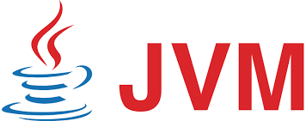
Installing Scala:
Can already run Spark Scala via REPL,
dse spark
Or, installing Scala,
Check for Java JDK 1.8
javac -version
Then,
wget http://downloads.typesafe.com/scala/2.11.8/scala-2.11.8.rpm
yum install *.rpm
Notes:
Any instructions above (and many that follow) were tested specifically on a CentOS 7 version Linux.

Slide 8

Apache Maven: What is it ?
Apache Maven is "build automation software". Think yum(C), or apt-get(C), (iTunes), but for Java programs.
-- Will create your project filesystem
structure, compile, deploy, other.
-- Will find, download, version, and
manage all of your Java/Scala
dependencies.
-- And, do all of this in about 4
total commands.
-- Supports Java, Scala, Ruby, C/C++
others
Notes:
Urls relative to Apache Maven:
https://en.wikipedia.org/wiki/Apache_Maven
https://maven.apache.org/guides/getting-started/maven-in-five-minutes.html

Slide 9

Apache Maven: How to install
Already installed ? "mvn --version"
If not, Tar ball; unzip, place in PATH
-- https://maven.apache.org/download.cgi
-- https://maven.apache.org/install.html
-- Version 3.5.4, 8MB in size
-- Is a Java app, requires Java 8 (v 3.5.4)
-- mvn --version
Run all commands in this unit inside a Linux terminal window.
Notes:
If Apache Maven is not already installed, you can download the Tar ball from the Url shown. Unzip, and place the new bin directory in your PATH.
All of these commands, and any that follow, are run inside a Linux terminal window.
Reference Urls,
https://blogs.oracle.com/arungupta/scala-and-maven-getting-started-guide-using-maven-scala-plugin-totd-170

Slide 10

Previously (6244/6245) when using Java-
Will be the Java Package name (as generated)
cd /opt (cd anywhere)
mvn archetype:generate \
-DgroupId=com.datastax.enablement.bootcamp \
-DartifactId=my-app \
-Dversion=1.0 \
-DinteractiveMode=false \
-DarchetypeArtifactId=maven-archetype-quickstart
Project name
(logical only)
Specific to Java
Notes:
Using Java, we execute both commands listed above; two bullet points, two commands. The text in blue is variable; choose whatever values you prefer.

Slide 11
When using Scala-
cd /opt (cd anywhere)
mvn archetype:generate \
-DgroupId=com.datastax.enablement.bootcamp \
-DartifactId=my-app \
-Dversion=1.0 \
-DinteractiveMode=false \
-DarchetypeArtifactId=scala-archetype-simple \
-DarchetypeGroupId=org.scala-tools.archetypes \
-DremoteRepositories=http://scala-tools.org/repo-releases
cd my-app
rm -r ./src/test/scala/samples/*
Different, calling for a Scala project
Specific to Scala
Generated tests: Will error on compile unless corrected
Notes:
The "mvn generate" command changes a bit when using Scala, specifically the, archetypeArtifactId.
If you do not correct the generated test code, a compile will fail; for speed (for now), delete the generated test code.

Slide 12
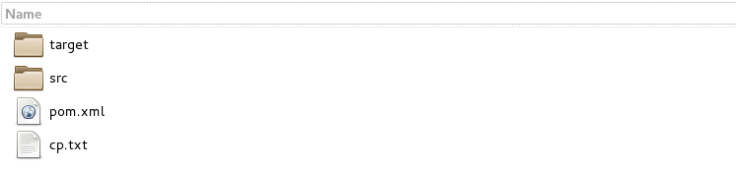







mvn generate: What just happened ?
-DgroupId=com.datastax.enablement.bootcamp
scala
App.scala
Notes:
The previous Maven command generated an entire project filesystem structure, from the current working directory, including stubs/other for unit testing, etcetera. This same command generated two specific artifacts of greater interest:
A pom.xml, see pages that follow
An App.scala, see pages that follow
The full pathname to our (App.scala) was generated from the "groupId" on a prior page

Slide 13
What is a pom.xml ?
<project xmlns="http://maven.apache.org/POM/4.0.0" xmlns:xsi="http://www.w3.org/2001/XMLSchema-instance" xsi:schemaLocation="http://maven.apache.org/POM/4.0.0 http://maven.apache.org/maven-v4_0_0.xsd">
<modelVersion>4.0.0</modelVersion>
<groupId>com.datastax.enablement.bootcamp</groupId>
<artifactId>my-app</artifactId>
<version>1.0</version>
<name>${project.artifactId}</name>
<description>My wonderfull scala
... (Lines deleted)
xml
"project object model"
Each project has one
Tells Maven how to compile, etc, your project
Edit once and done ?
Notes:
The contents of pom.xml are displayed. Comments:
While XML formatted, the (syntax of a POM) is far reaching, and can become complex for true enterprise projects.
We will, in this unit, cover most aspects of a POM relative to compiling DSE Scala client programs.

Slide 14
What's in App.scala ?
package com.datastax.enablement.bootcamp
/**
* @author ${user.name}
*/
object App {
def foo(x : Array[String]) =
x.foldLeft("")((a,b) => a + b)
def main(args : Array[String]) {
println( "Hello World!" )
println("concat arguments = " + foo(args))
}
}
Stub
It runs (it's Hello World)
Add DSE client code; structure
Notes:
The contents of App.scala are displayed. Comments:
A stub program; this program will run.
We will add to this program on the pages that follow.

Slide 15
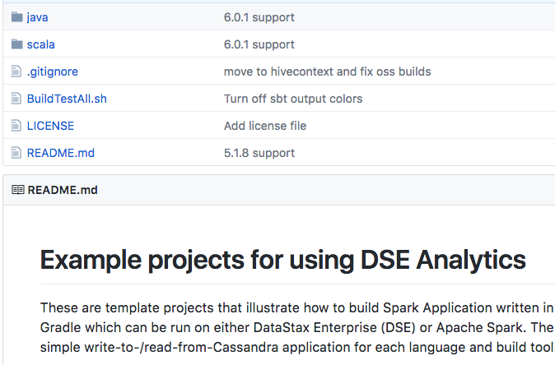
Did Maven know about DSE/Spark ?
No. (And versions.)
Get a correct pom from DataStax
Url on Notes page
Notes:
While you could easily (?) edit the pom.xml to include support for the DSE Spark Cassandra Connector, and related, we consider it faster to copy a pom.xml from the DSE GitHub (support) Url; pasted below.
Reference Urls,
https://github.com/datastax/SparkBuildExamples
https://github.com/datastax/SparkBuildExamples/blob/master/scala/maven/dse/pom.xml

Slide 16
To compile and run a Java (Scala, kind of) program-
From the "project directory"
cd /opt/my-app
# compiles
mvn package
# generates the Java CLASSPATH
mvn dependency:build-classpath -Dmdep.outputFile=cp.txt
# call to run the program (one line below)
java -cp target/my-app-1.0.jar:`cat cp.txt`
com.datastax.enablement.bootcamp.App
-DgroupId=com.datastax.enablement.bootcamp
-DartifactId=my-app
Left single apostrophes
Notes:
Comments relative to the above:
The sequence of commands above would actually compile and (run) a DSE Spark Scala program; (it would compile and run the Scala commands, the Spark commands will not output/function).
All of the Maven commands (mvn) are run from the parent directory of the project.
"mvn package" calls to compile
A compile error might appear similar to,
[INFO] -------------------------------------------------------------
[ERROR] COMPILATION ERROR :
[INFO] -------------------------------------------------------------
[ERROR] /mnt/hgfs/My.18/MyShare_1/19 Matts Department/SC - Structured Content/
30 - Core/02 - Resource Kit/87 - java_driver/my-app/src/main/java/com/
datastax/enablement/bootcamp/
App.java:[183,41] error: cannot find symbol
[ERROR] class App
The above is a Java syntax error on line 183, character space (column) 41 of App.java
Non-trivial Java programs might reference dozens or more class files, and it is the Java CLASSPATH that tells the Java JVM where to locate same. Thus, it's handy to have someone (Maven) generate the CLASSPATH for you.
The "mvn dependency" line automatically generates CLASSPATH and puts it in a file titled, cp.txt
We call to reference this file below, when running.
And the last Maven command calls to run our program (App.java)
Those are left single apostrophes around the ( cat cp.txt ) command.
You should see "Hello World" printed on the terminal window.

Slide 17

The better sequence for DSE/Spark/Scala: Next steps
Edit, compile, test, (repeat)
From the parent directory of the project; from ( ./my-app/ )
mvn package
dse spark-submit --class \
com.datastax.enablement.bootcamp.App target/my-app-1.0.jar
New/odd Jars ? Put them in the pom.xml
Notes:
Next steps:
Write Scala; a program that does more with the Spark, and the DSE database
Comments relative to the above:
All of the Maven commands (mvn) are run from the parent directory of the project.
"mvn package" calls to compile
A compile error might appear similar to,
[INFO] -------------------------------------------------------------
[ERROR] COMPILATION ERROR :
[INFO] -------------------------------------------------------------
[ERROR] /mnt/hgfs/My.18/MyShare_1/19 Matts Department/SC - Structured Content/
30 - Core/02 - Resource Kit/87 - java_driver/my-app/src/main/java/com/
datastax/enablement/bootcamp/
App.java:[183,41] error: cannot find symbol
[ERROR] class App
The above is a Java syntax error (Scala is nearly the same) on line 183, character space (column) 41 of App.(java)
And the last command calls to run our program (App.scala). You should see "Hello World" printed on the terminal window.

Slide 18
DSE Spark Scala:
For brevity, this example does not display the two additional/derived columns.
End to end example; imports, DSE Analytics (Spark) Session object, other
Example, end to end
Notes:
In this section we begin an end to end, complete DSE/Spark/Scala example.

Slide 19
Just customer: end to end example-
// Run this CQLSH block first, before running this program.
//
// DROP KEYSPACE IF EXISTS ks_7545;
// CREATE KEYSPACE ks_7545 WITH REPLICATION =
// {'class': 'SimpleStrategy',
// 'replication_factor': 1};
// USE ks_7545;
//
// CREATE TABLE customer_plus_derived
// (
// customer_num INT PRIMARY KEY,
// fname TEXT,
// ... lines deleted
// phone TEXT,
// company_upshift TEXT, // This column not in CSV input file
// ew_flag TEXT // This column not in CSV input file
// );
Notes:
The CQL code necessary to give us a DSE table to write into; just customer, and with the two additional/derived columns displayed.

Slide 20
Just customer: end to end example-
package com.datastax.enablement.bootcamp
import com.datastax.spark.connector._
//
import com.datastax.spark.connector.cql.CassandraConnector
//
import org.apache.spark.sql.{SaveMode, SparkSession}
import org.apache.spark.sql.cassandra._
//
import org.apache.spark.sql.types._
Notes:
The package statement, and necessary package imports.
You could, if you wished, reverse engineer which statements in the program proper require any of these imports.

Slide 21
Just customer: end to end example-
object App {
// If this case class is not outside the main,
// we can get a compiler error,
case class My_Record (
customer_num : Int,
fname : String,
lname : String,
company : String,
address1 : String,
address2 : String,
city : String,
state : String,
zipcode : String,
phone : String
)
Notes:
In an actual Scala program (not in the Scala REPL), the DSE Spark Cassandra Connector required that this case class be defined outside our only block, which is the main. StructField has no such requirement.

Slide 22
Just customer: end to end example-
def main(args : Array[String]) {
val spark = SparkSession.builder
.appName("My App")
.getOrCreate()
val sc = spark.sparkContext
// You will need this line eventually
//
// import spark.implicits._
// ------------------------------
Notes:
The main, and getting a Spark context.
spark.implicits._ is a package containing many of the transforms you will want in a larger, production capable application.
This package is subject to the "spark." object reference, and as such, may not be placed along the earlier imports.

Slide 23
Just customer: end to end example-
// Reading from a DSE table
//
// val rows10 = spark.sparkContext.cassandraTable(
// "system", "local").select("dse_version")
val rows10 = sc.cassandraTable("system", "local").
select("dse_version")
rows10.collect().foreach(println)
println()
// ------------------------------
Notes:
The commented codes displays the "sc" object reference in long form.
Reading from a given DSE table (known to exist).

Slide 24
Just customer: end to end example-
// Reading a CSV, but as a text file; List of Strings
//
val rows20 = sc.textFile("file:///opt/stores_db/customer.csv")
rows20.collect().foreach(println)
println()
// split returns an array
//
val rows21 = rows20.map ( line => line.split (","))
// map the array elements (by position) into our record
//
val rows22 = rows21.map ( p => My_Record ( p(0).toInt,
p(1).toString, p(2).toString, p(3).toString,
p(4).toString, p(5).toString, p(6).toString,
p(7).toString, p(8).toString, p(9).toString ))
rows22.collect().foreach(println)
println()
Notes:
Reading the customer.csv as a string, which we then split and further process.

Slide 25
Just customer: end to end example-
rows22.saveToCassandra("ks_7545", "customer",
SomeColumns( "customer_num" , "fname",
"lname" , "company" ,
"address1" , "address2" ,
"city" , "state" ,
"zipcode" , "phone" ))
// ------------------------------
Notes:
And writing same to DSE.

Slide 26
Just customer: end to end example-
// The above is subject to error; positional array reading
//
// Reading directly into a StructType; can't use a case class
// with the read.schema below-
//
val My_Schema = StructType(Array(
StructField("customer_num" , IntType, true),
StructField("fname" , StringType, true),
StructField("lname" , StringType, true),
StructField("company" , StringType, true),
StructField("address1" , StringType, true),
StructField("address2" , StringType, true),
StructField("city" , StringType, true),
StructField("state" , StringType, true),
StructField("zipcode" , StringType, true),
StructField("phone" , StringType, true)
))
Notes:
Preparing to read customer.csv into a StructField.

Slide 27
Just customer: end to end example-
// Reading the CSV into a StructType actually returns a DataFrame
//
// . Reading a CSV requires a schema (which gets us into DataFrame
// territory)
// . That is cheating at this point
//
// . Reading as a text file, and parsing this string with confidence
// is a lot of code we want to avoid.
//
val rows30 = spark.read.schema(My_Schema).csv(
"file:///opt/stores_db/customer.csv")
// Convert the DataFrame to RDD
//
val rows31 = rows30.rdd
rows31.collect().foreach(println)
println()
Notes:
The preferred syntax to earlier, although we are using a DataFrame read CSV method.

Slide 28
Just customer: end to end example-
// ks_7545.customer must exist
//
rows31.saveToCassandra("ks_7545", "customer",
SomeColumns( "customer_num" , "fname",
"lname" , "company" ,
"address1" , "address2" ,
"city" , "state" ,
"zipcode" , "phone" ))
// ------------------------------
// We need these lines in order to terminate the program
//
spark.stop()
sys.exit(0)
}
}
Notes:
Final wrote to DSE, and program exit.

Slide 29
End of Unit:
Notes:
End of Discussion Unit-

Slide 30
Additional Detail:
Notes:
The remaining content may be read “extra credit”, as time allows.

Slide 31
DSE Java Driver-
On top of the open source driver sits the DSE Driver-
Specific extensions for DSE
-- Authenticator implementations that use the authentication
scheme negotiation in the server-side DseAuthenticator
-- Value classes for geospatial types, and type codecs that
integrate them seamlessly
-- Continuous Paging
-- DSE graph integration
-- https://github.com/datastax/java-dse-driver
Only allowed to use if you have a valid DSE License
Notes:
Again: Discussion Unit 6244/6245 provide discussion and an exercise using the DSE Java driver.

Slide 32
DSE Spark (Cassandra) Connector-
Exposes (Cassandra) tables as Spark RDDs, DataFrames, Datasets
Read, write, and more
Execute arbitrary CQL queries in your Spark applications
Used with the Cassandra Java Driver
Open Source Apache 2.0 license
DataStax Github Repository, https://github.com/datastax/spark-cassandra-connector
Use cases:
Streaming data into DSE
Analyzing the data in place
Migrating from bad data model
Notes:
We use the DSE Spark (Cassandra) Connector in the exercise that follows.

